Slide 1
Game Flux Analysis with Provenance
Authors: Troy C. Kohwalter,
Esteban W. G. Clua, Leonardo G. P. Murta
Instituto de Computação – Universidade Federal Fluminense (UFF)

Slide 2

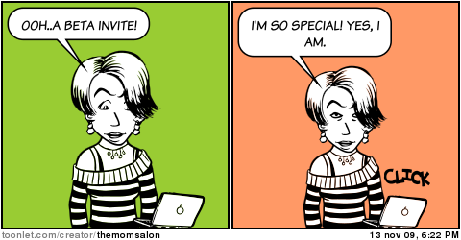
Context
Analysis Process
Technical Issues
Gameplay Mechanics
Beta Testing
Indispensable Source of Data
Artisanal
Volunteers
Superficial Analysis
Notes:
Nowadays, the analysis process for detecting gameplay and technical issues is done in an artisanal way by using the popular beta testing approach, which is an indispensable source of data for game developers.
Normally, beta testers are volunteers who plays the game in an early, pre-release, build of the game where they can provide information about technical issues and feedback about the gameplay mechanics.
However, the feedback contains only the issues that the beta tester could notice while playing. Some problems can be deeper and not easily perceptible or generates subtle effects in the game dynamics that escapes the tester’s perception.
Furthermore, developers have little control over the beta testers’ gameplay experience or the environment and rely heavily on how the issue was reported.

Slide 3

Motivation
Cause-and-Effect
How to detect?
How to display?
Archeology, Paleontology
Provenance
Notes:
No entanto, outras áreas utilizam um outro método de analise, permitindo saber com mais detalhes as transformações ou alterações sofridas pelas entidades envolvidas. Esse método é baseado em Proveniência.

Slide 4
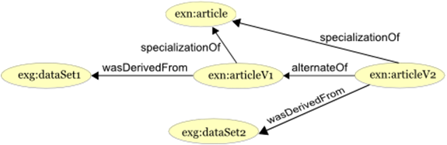
Provenance
“Refers to the documented history of an art object, or the documentation of processes in a digital object’s life cycle”
Provenance Graph
Causality Graph
Models:
OPM (2007)
PROV (2010)
http://www.w3.org/TR/prov-primer/
Notes:
By its definition, Provenance refers to the documented history of an art object or the documentation of processes in a digital object’s life cycle
It uses a provenance graph to display the provenance information, which is a directed graph representing the causality relationships between the entities involved.
Currently there are two provenance models: the Open Provenance Model and PROV. This work is based on the PROV notation.

Slide 5

Goals
Cause-and-Effect Relationships
Detect
Extract
Display
Assist
Detect Gameplay Issues
Visualization
Game Session Provenance

Slide 6

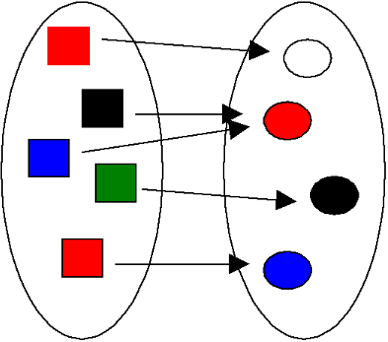
Provenance in Games
Previous Work
Conceptual Framework
Map Domains
Provenance to Games
Gather
Provenance Information
Notes:
In our previous work, we presented a conceptual framework called Provenance in Games, which maps elements from the provenance domain to games domain and also allows for gathering provenance information from a game session

Slide 7
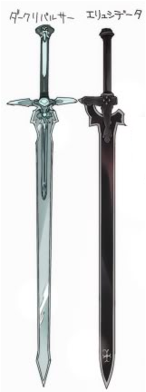
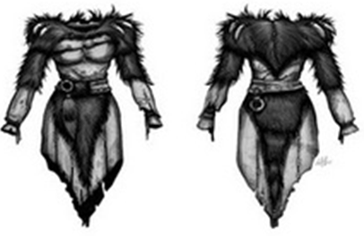
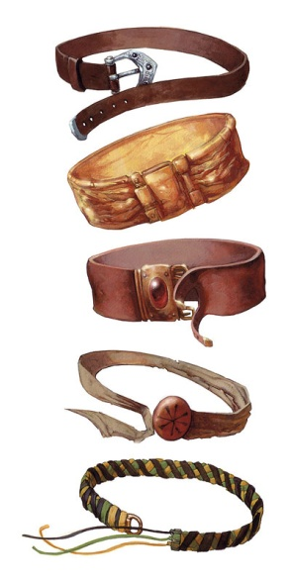
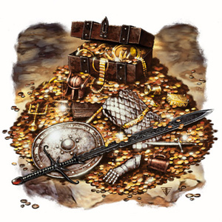
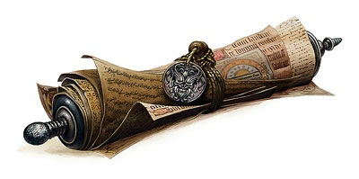
Provenance Gathering
Entity
Objects
Activity
Actions
Events
Agent
NPCs
Player
Notes:
This is the mapping from provenance to games.
Entities were mapped to inanimate game objects

Slide 8
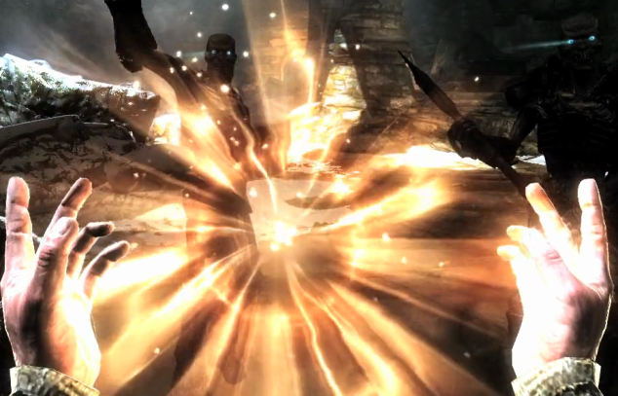
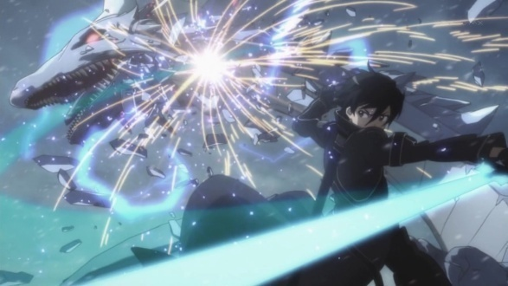
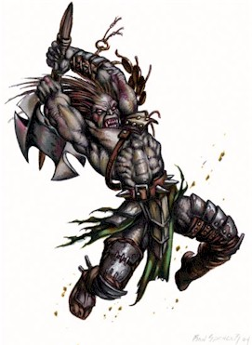
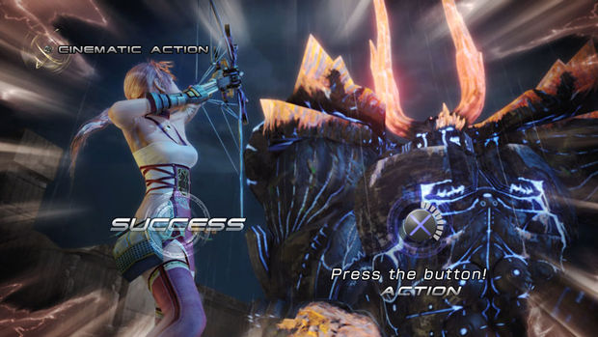
Provenance Gathering
Entity
Objects
Activity
Actions
Events
Agent
NPCs
Player
Notes:
Activities to actions and events

Slide 9
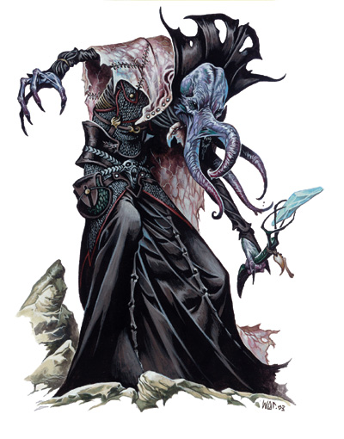
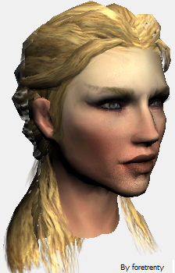
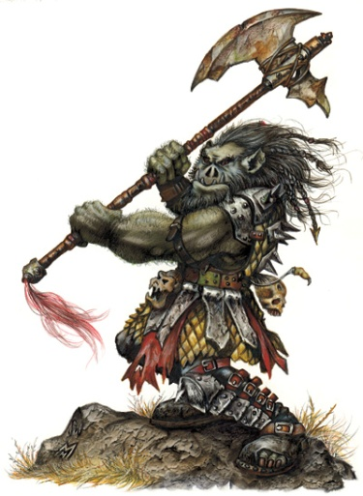

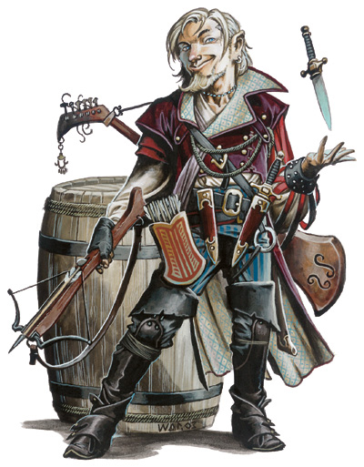
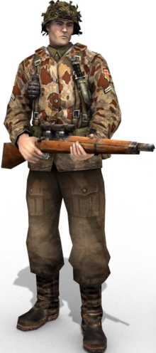
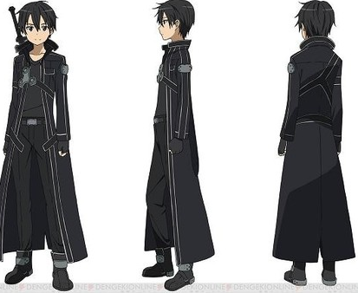
Provenance Gathering
Entity
Objects
Activity
Actions
Events
Agent
NPCs
Player
Notes:
And agents to game characters like NPCs and Players

Slide 10
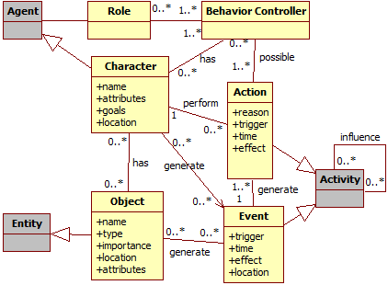
Provenance to Games
Notes:
This class diagram shows this mapping from our previous work, illustrating some important information to be extracted for each entity type

Slide 11
Graph Construction
Mage
Orc
Notes:
Now I will show by example how the information is gathered and stored for the provenance graph.
Imagine a combat between two characters: A mage and an Orc
Each character has a list of actions, which contains all actions executed by him

Slide 12
Graph Construction
Mage
Orc
- 23hp
Spell:
Lightning Bolt
Notes:
Starting the combat, the mage cast a spell named Lightning Bolt, which damages the orc.
First we add the action in the Mage’s action list, then we check for influences.
Since the spell caused damage, we need to store the relationship between the source and the target plus the effect, which is the spell, the orc and the damage value.

Slide 13
Graph Construction
Mage
Orc
- 23hp
Spell:
Lightning Bolt
- 18hp
Attack
(Hit)
Notes:
The next turn the orc attacks the mage and score a hit, damaging him.
Similarly to the previous case, we store the action, the relationship between the action and the agent that suffered damage, and the value.

Slide 14
Graph Construction
Mage
Orc
- 23hp
Spell:
Lightning Bolt
- 18hp
Attack
(Hit)
+ 15hp
Spell :
Heal
Notes:
Next turn the mage cast a spell to heal his wounds

Slide 15
Graph Construction
Mage
Orc
- 23hp
Spell:
Lightning Bolt
- 18hp
Attack
(Hit)
+ 15hp
Spell :
Heal
Attack
(Miss)
Notes:
The orc attacks, but miss the mage. So we only need to store the action, since it did not generate any influence.

Slide 16
Graph Construction
Mage
Orc
- 23hp
Spell:
Lightning Bolt
- 18hp
Attack
(Hit)
+ 15hp
Spell :
Heal
Attack
(Miss)
Spell :
Stoneskin
Notes:
The mage cast a spell named Stoneskin, which decreases damage taken. Due to the nature of the spell, which affects future attacks, we need to save this possible influence for future actions.

Slide 17
Graph Construction
Mage
Orc
- 23hp
Spell:
Lightning Bolt
- 18hp
Attack
(Hit)
+ 15hp
Spell :
Heal
Attack
(Miss)
- 8hp
Spell :
Stoneskin
Attack
(Hit)
Reduced 10 damage
Notes:
On the last turn, the orc attack and hit the mage. So we store the action, the damage dealt and the influence from the previously casted spell stoneskin had on the attack.

Slide 18

Provenance Visualization
Notes:
The provenance visualization is done through a provenance graph, which is a visual representation of the game provenance.
To assist the graph analysis, we adopted a series of features to distinguish information. Starting with the vertices, we use different shapes to represent different types: Circles for Entities, Octagons for Agents, and Squares for Activities.

Slide 19
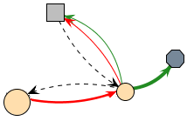
Provenance Visualization
Notes:
The relationships between vertices, which is represented by the graph’s edges, can also be distinguished by thickness and color.
Green edges represent good influences while red represents bad ones. The thickness is used to determine how much it influenced.

Slide 20
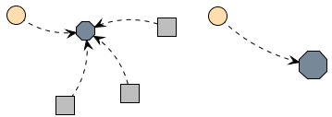
Provenance Visualization
Notes:
Another feature is the collapse, which allows to omit information or reduce the graph’s granularity.

Slide 21
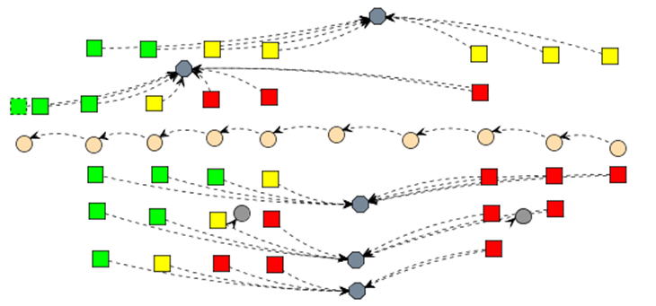
Provenance Visualization
Notes:
Lastly, different display modes that alters the vertices color for easier identification of special cases or situations. Such mode can be used to evaluate a certain type of value, like Hit Points, or to quickly identify certain types of actions.
For value analysis we adopted a 3 color scheme: Green for high or good values, yellow for moderate and red for low or bad values.

Slide 22
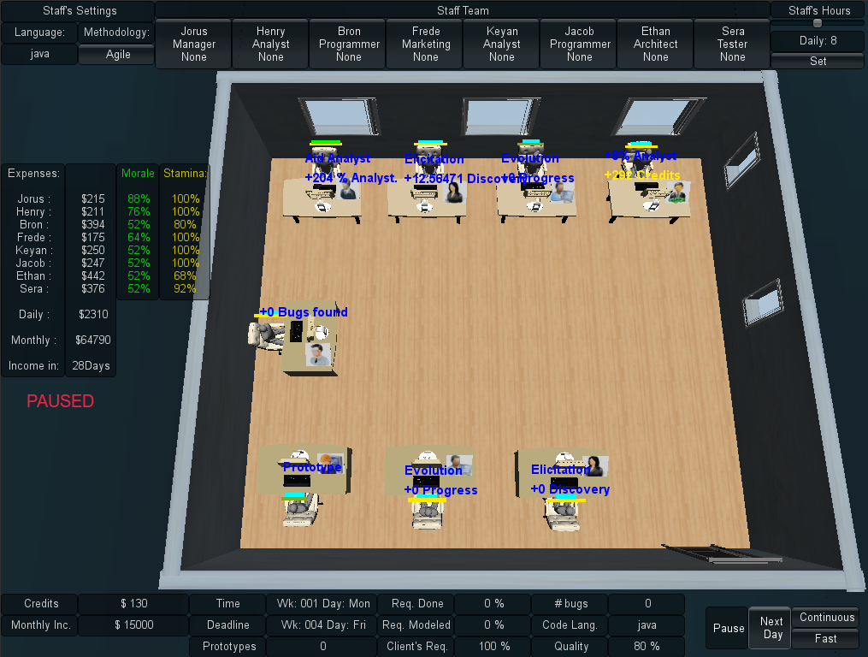
Case Study
Notes:
We instantiated the conceptual framework and provenance visualization in a serious game named SDM, which was developed by us.
SDM is a game focused on teaching Software Engineering techniques where the player control a development staff to produce software. Actions made by the player can generate influences in other actions, affecting tasks performed by his employees.

Slide 23
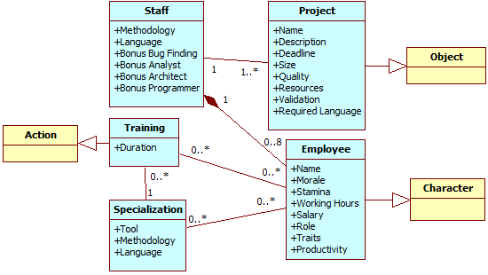
Case Study
Notes:
This is the mapping of SDM components to the Game in Provenance framework

Slide 24
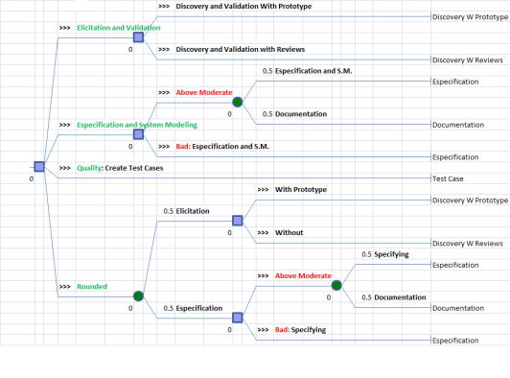
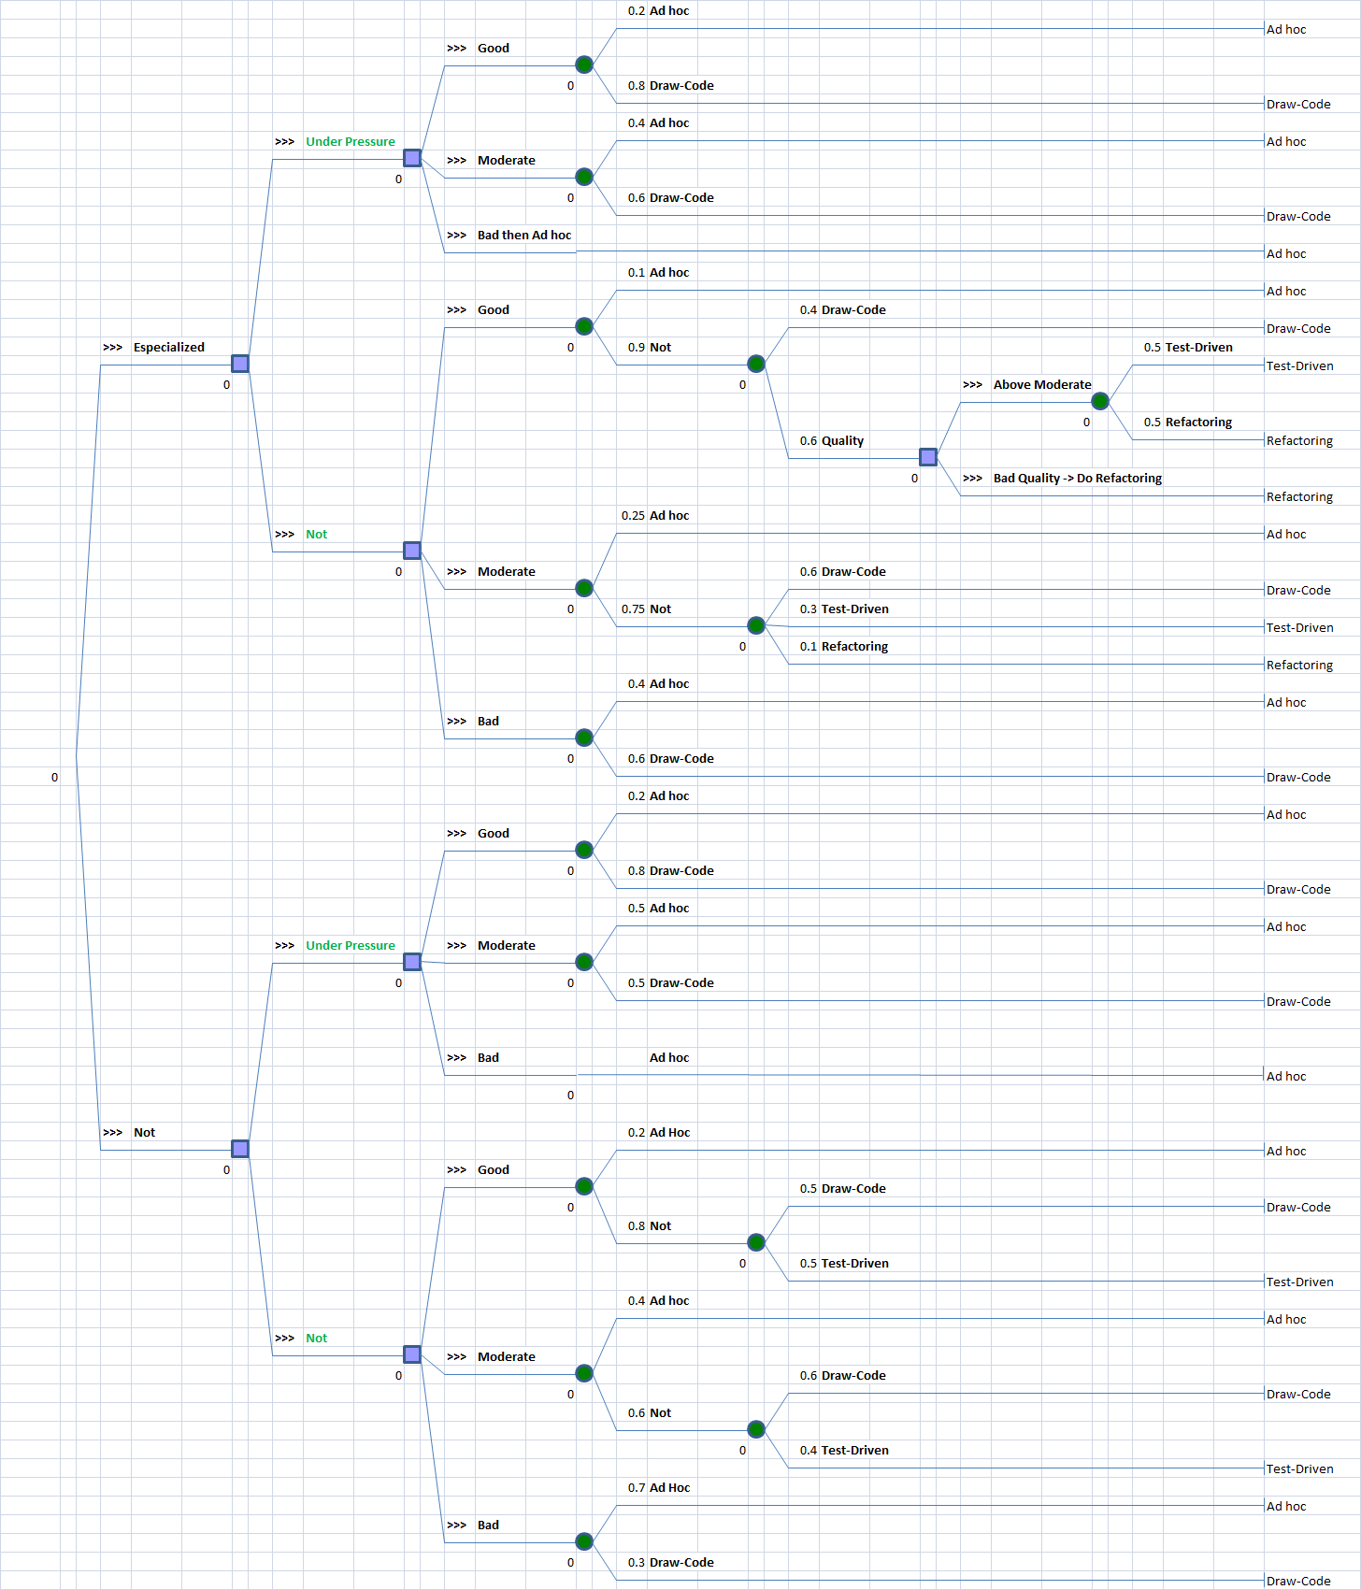
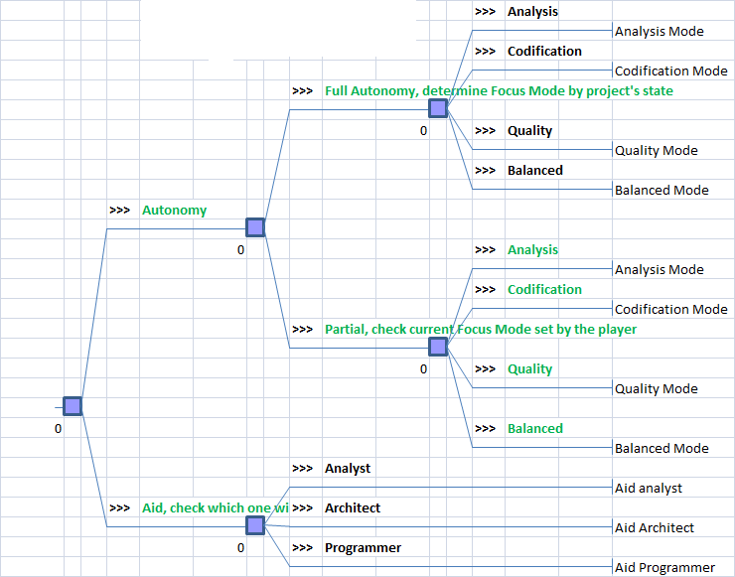
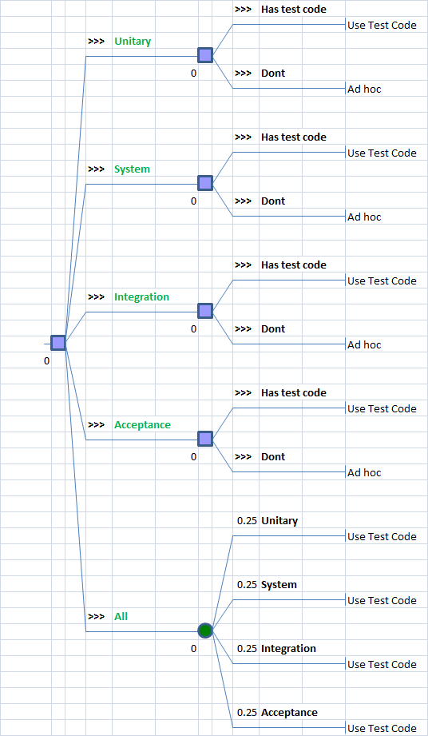
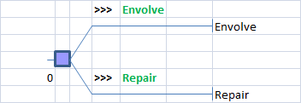
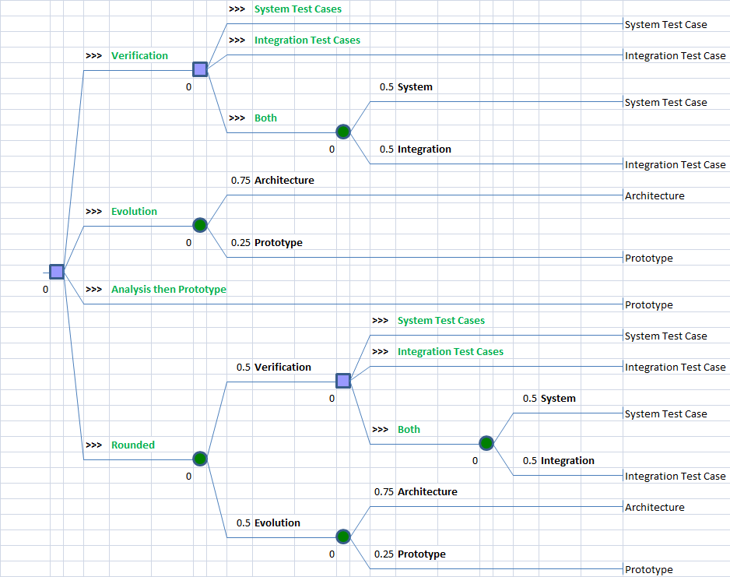
Case Study
Notes:
The method used to gather information was based on Decision Trees, where the leaf nodes is where the action is executed, while the information gathered is from the path between the leaf and the root of the tree, including the factors that influenced the action.

Slide 25
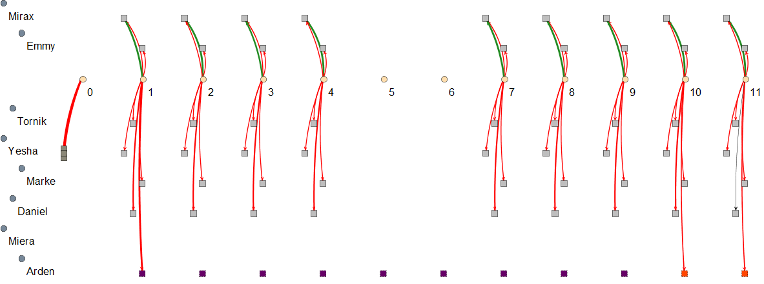
Visualization Examples
Notes:
This is an example of visualization for the influences in the player’s financial status

Slide 26
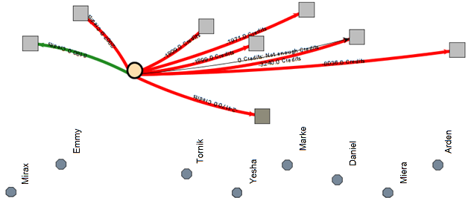
Visualization Examples
Notes:
This is the same example but collapsing each agent’s activities into one for easier numerical analysis due to the vertex and edge collapses

Slide 27


Conclusion
Contributions
Rich Data Extraction
Broader Range of Analysis
Cause-and-Effect Relationships
Game Provenance Visualization
Future Work
Automatic Inferences
Pattern Detection
Graph Layouts

Slide 28
Game Flux Analysis with Provenance
Authors: Troy C. Kohwalter,
Esteban W. G. Clua, Leonardo G. P. Murta
Instituto de Computação – Universidade Federal Fluminense (UFF)

Slide 29
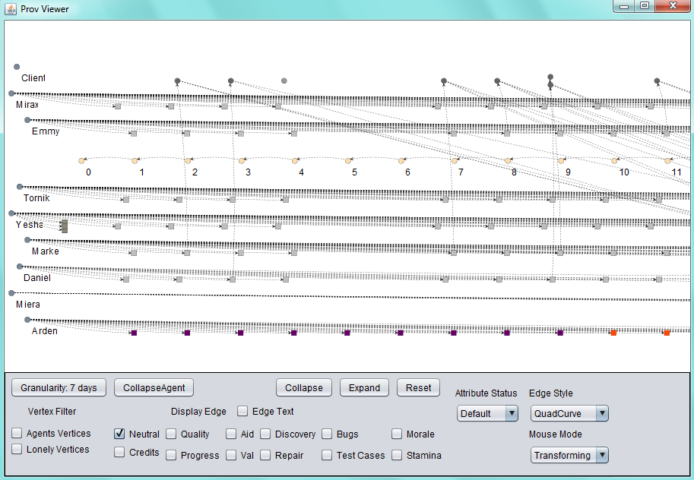
Visualization Examples
Notes:
Visualization
Falar que esse grafo é referente a sessão de jogo utilizada no experimento, e quem jogou foi o autor.

Slide 30
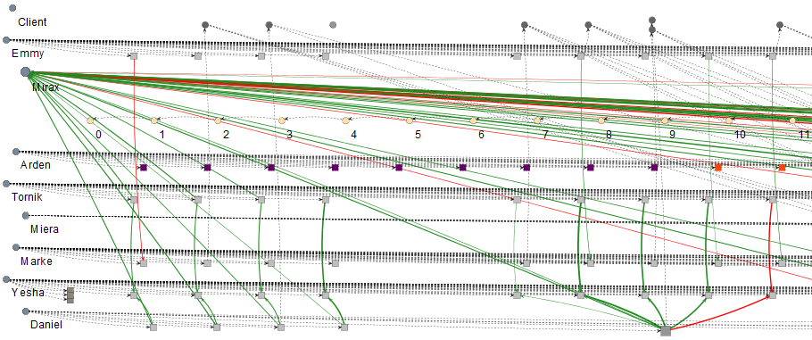
Visualization Examples
Notes:
Agent Collapse: Agent’s Influences

Slide 31
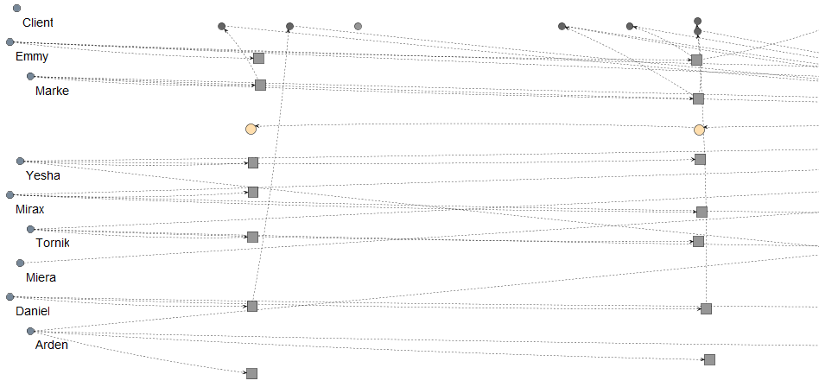
Visualization Examples
Notes:
Granularity

Slide 32
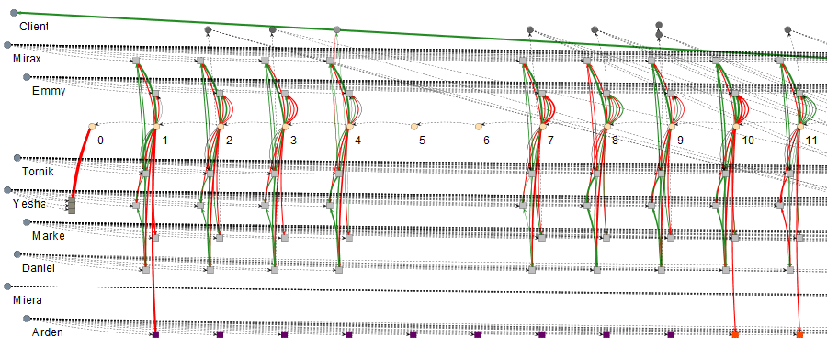
Visualization Examples
Notes:
Influences

Slide 33
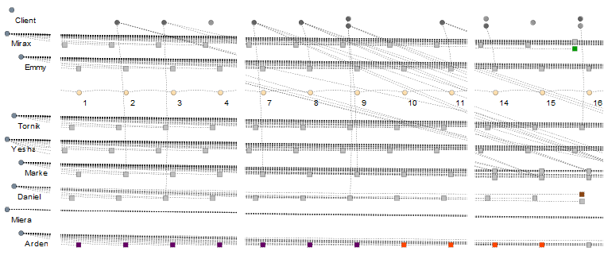
Visualization Examples
Notes:
Vertex types/color
Verde: Promovido
Marrom: Pediu Demissao
Vermelho: Ocioso
Roxo: Treinamento

Slide 34
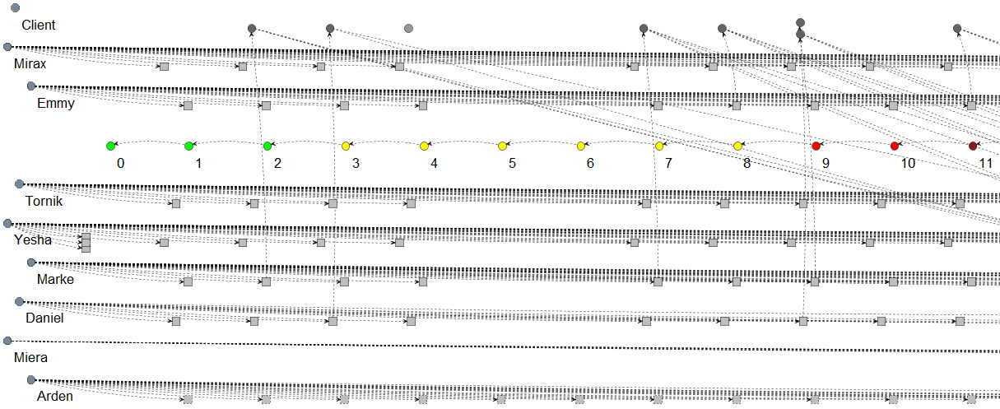
Visualization Examples
Notes:
Vertex attribute display: Credits

